Slide 1
r/Technology
What can we learn?

Slide 2
What is Reddit?

Slide 3
r/Aww

Slide 4


Slide 5
r/dataisbeautiful

Slide 6
r/NBA

Slide 7
r/rabbits

Slide 8
r/technology

Slide 9
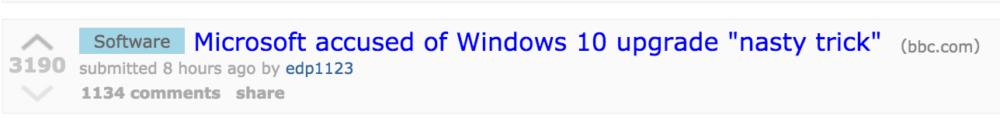

Slide 10
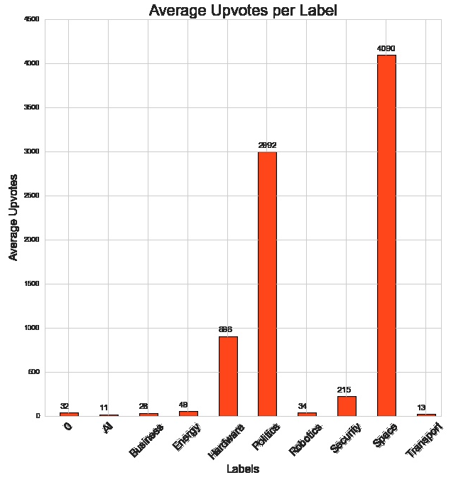

Slide 11
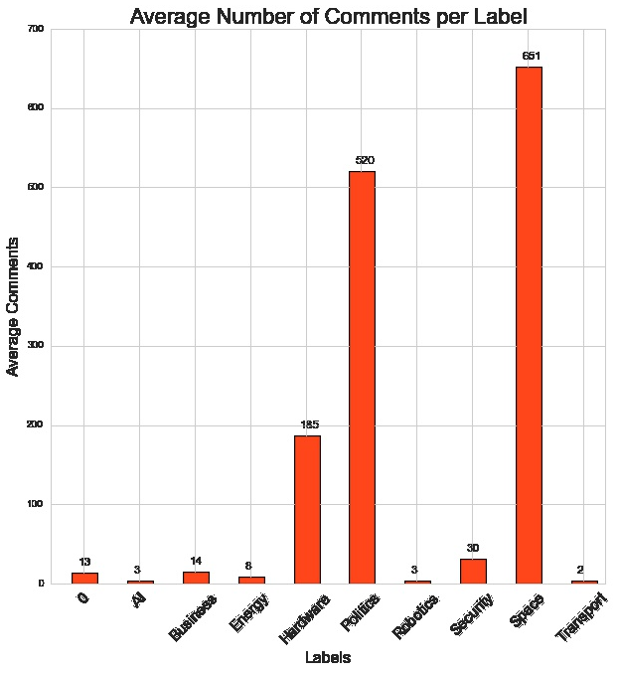

Slide 12
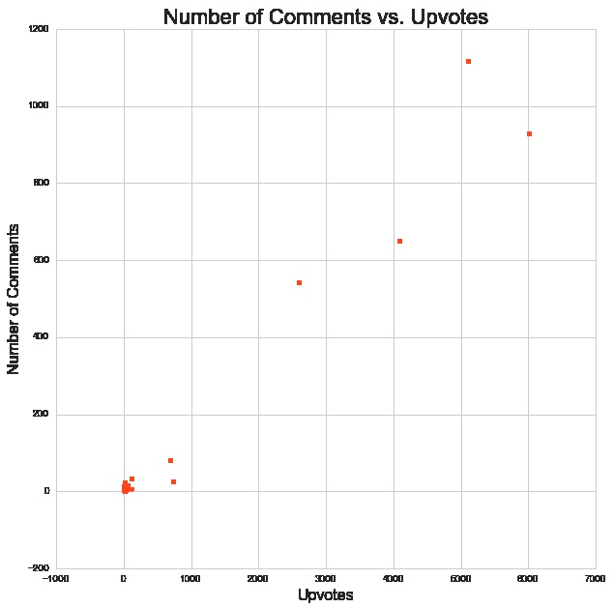

Slide 13
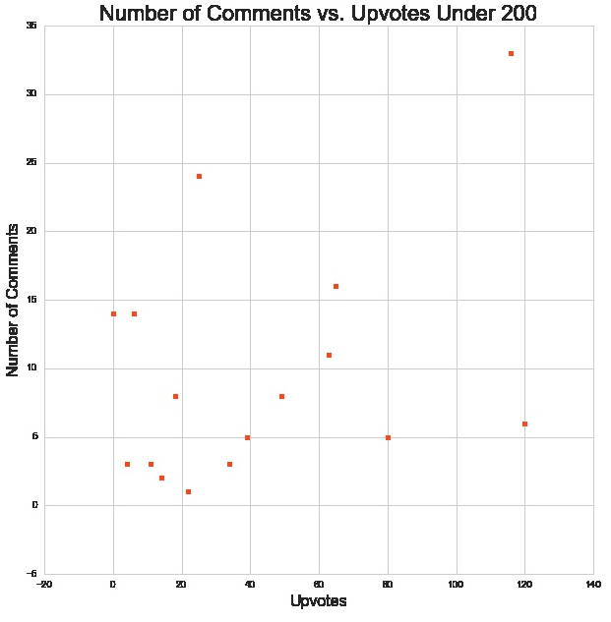

Slide 14
What are the next steps?

Slide 15


